Slide 1

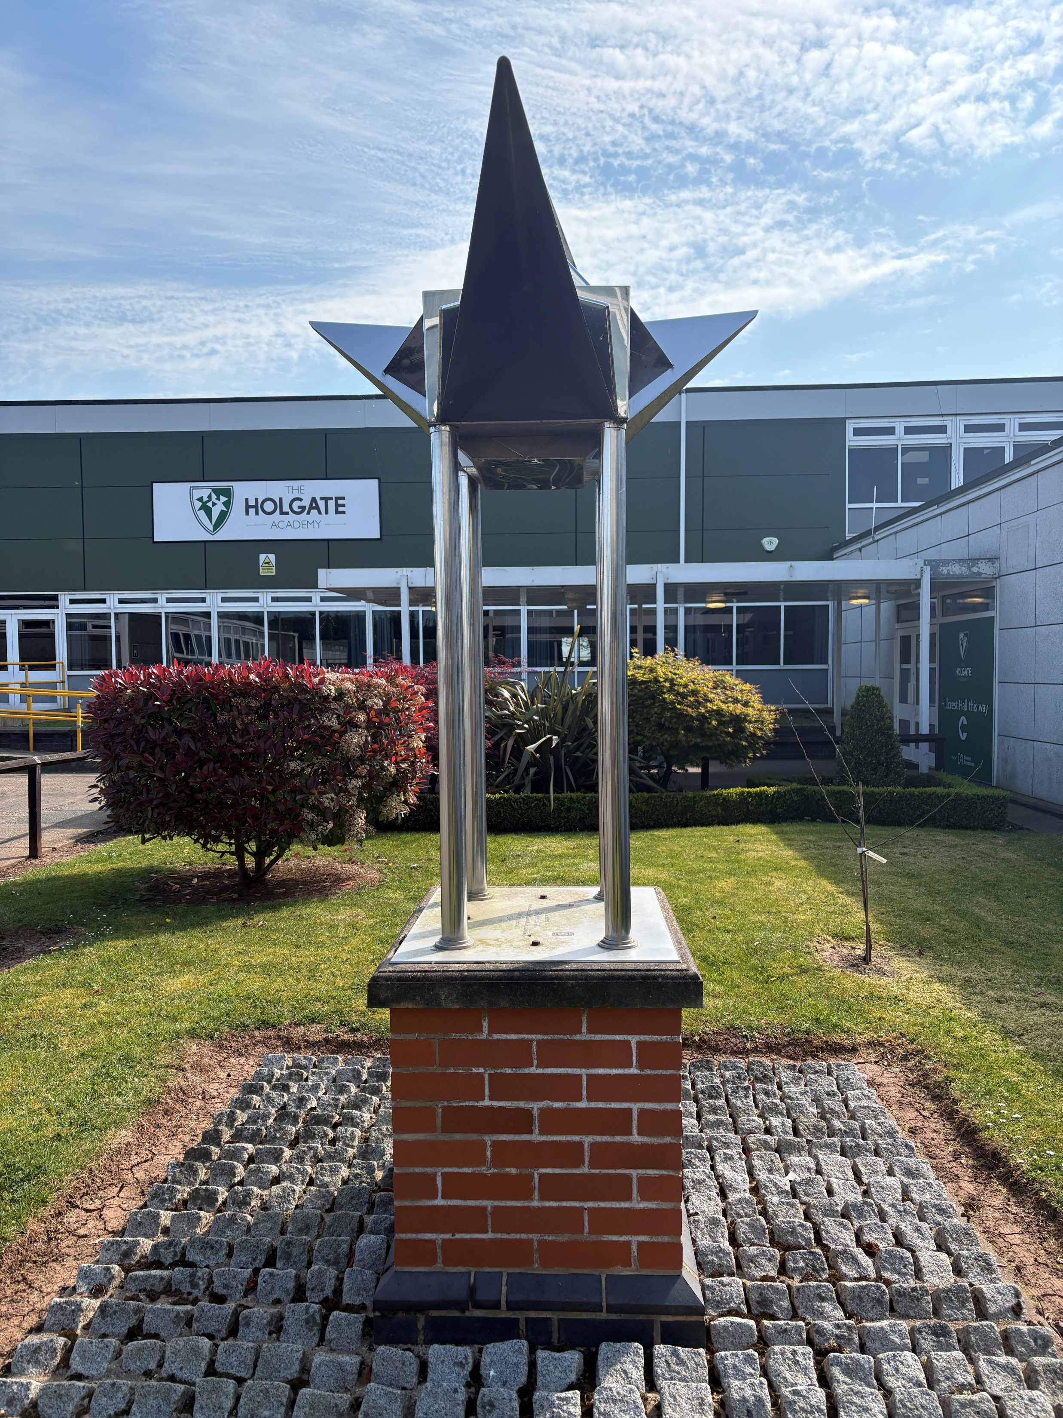

Transition
2026

Slide 2
The plan moving forwards…
Information gathering/communication with the primary schools – the transition team will be going into schools to meet the students and staff
Transition packs (welcome letter, transition booklet, data collection form) – sent to feeder primaries and then directly to singular students
SEND extra transition visits and SEND team present at events
Site tours – will take place on Wednesday 3, 10, 17 and 24 June 3.45-4.30pm with the SEND team available 4.30-5pm. Booking live on Eventbrite – links sent via primary schools.
Transition days 15, 16 and 17 July (Parent event on the Thursday evening – 16 July) – attendance and SEND team present
Formally accepting the place – this aids with communication
Groupings (info from primary schools and then moving into year 7)
Any questions?
Contact can be made to the transition team via email – transition@holgate-ac.org.uk
GCSE
results day 2018
Equipping students for success

Slide 3

Supporting young carers at Holgate
What is a young carer?
A young carer is someone aged between 5 and 17 who provides care, assistance and support to a relative at home who has an illness, a disability, mental health problems or drug and alcohol problems.
Mrs A Wilford
Please complete the section on the contact details form.
Parents can come to discuss support, provisions, advice and further assistance from outside agencies on young carers with Mrs Wilford
Through the school, registered young carers will be mentored by TuVida charity and Nottinghamshire Young carers.
What can school support with:
Accessing homework clubs and supporting when students are struggling with the balance of caring for a loved one and their education
Introduce you to peers who are experiencing the same thing and support each other
Celebrate your achievements with you
Equipping students for success

Slide 4
Transition days are 15, 16 and 17 July 2026!
Meet the tutor event 16 July at
4pm
4.45pm
5.30pm
Transition tours are 3,10,17 and 24 June 2026!
3.45pm Start time
Equipping students for success

Slide 5


